Slide 1
HPLC Origami separation

Slide 2
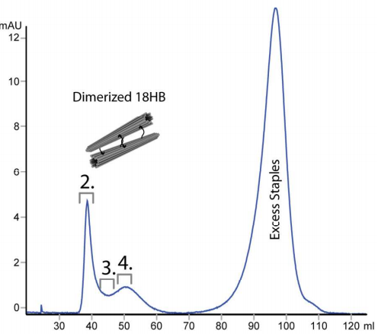
Previous literature
Purification of Functionalized DNA Origami Nanostructures
Alan Shaw, Erik Benson
Column: Sephacryl S500 Size Exclusion, Particle Size: 50 µm
Origami Monomer: 18 helix-bundle, 15120 bases, 2268kD
No separation was detected between
monomer and dimer.
“The Sephacryl S500 column was unable
to separate the dimeric and the
monomeric DNA origami.”

Slide 3
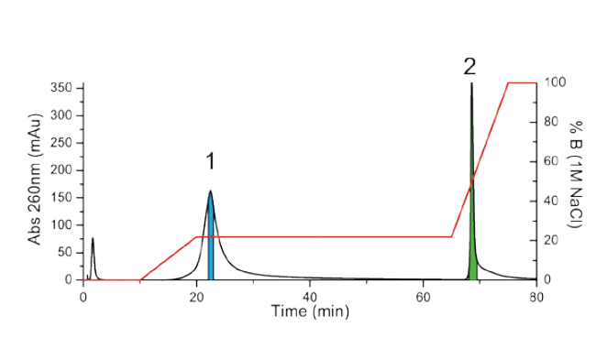
Previous literature
Direct observation of stepwise movement of a synthetic molecular transporter
J. Turberfield
Column: Weak ion exchange column (DEAE Sepharose, GE Healthcare), Particle size: 90 µm
Gradient: 100mM NaCl, 1×tris-acetate, 12.5 mM magnesium acetate
Origami Monomer: 14498 bases, 21745kD
No separation between monomer and dimer
Staples
Origami

Slide 4
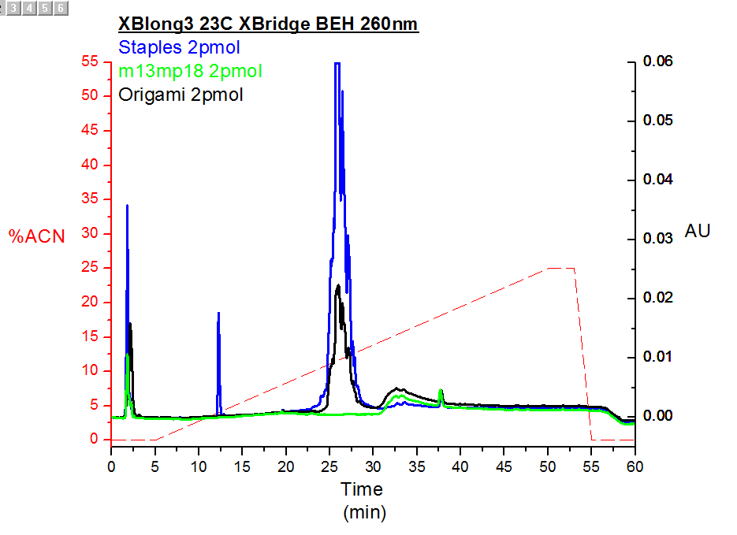
Our Run
Column: Xbridge BEH Reverse phase, Particle size: 3.5 µm, Pore size: 300A
Gradient: ACN
Origami Monomer: 14498 bases, 21745kD
origami monomer and dimer are flushed out of the column before the detector start measuring

